Slide 1
The Cantersteen Library
Rotary Club Brussels Cantersteen
Juin 2020

Slide 2
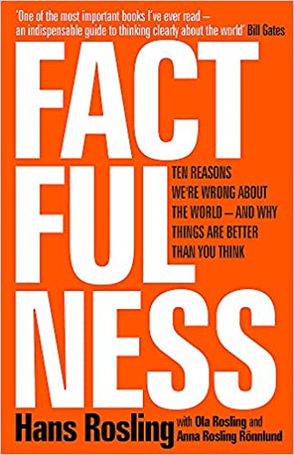
Hendrik ’s First Choice
INSTANT NEW YORK TIMES BESTSELLER
“One of the most important books I’ve ever read―an indispensable guide to thinking clearly about the world.” – Bill Gates
“Hans Rosling tells the story of ‘the secret silent miracle of human progress’ as only he can. Every Rotarian should read this .Factfulness does much more than that. It also explains why progress is so often secret and silent and teaches readers how to see it clearly.” ―Hendrik DE HERTOGH
"Factfulness by Hans Rosling, an outstanding international public health expert, is a hopeful book about the potential for human progress when we work off facts rather than our inherent biases." - Former U.S. President Barack Obama
https://www.amazon.com/Factfulness-Reasons-World-Things-Better/dp/1250107814

Slide 3
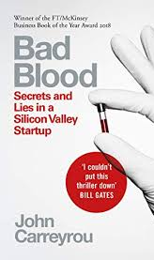
Hendrik ’s Second Choice
‘Bad Blood’ Review: How One Company Scammed Silicon Valley. And How It Got Caught
https://www.amazon.fr/Bad-Blood-Secrets-Silicon-Startup/dp/1509868089/ref=pd_lpo_14_t_0/261-7832208-7601603?_encoding=UTF8&pd_rd_i=1509868089&pd_rd_r=2164f4ee-d122-4af3-8737-e8f0b670bd21&pd_rd_w=J3FM3&pd_rd_wg=hgcRz&pf_rd_p=a9e8383d-b25d-45ec-acc2-a094dd781c31&pf_rd_r=2YKY8BB2ZRVRS1KHA2AK&psc=1&refRID=2YKY8BB2ZRVRS1KHA2AK

Slide 4
Rob’s First Choice
Great Expectations In Europe II, 1999-2019
While In Europe (2004) covered the tumultuous 20th century and the legacy of the two world wars, Great Expectations takes stock of the early 21st century. Mak turns his keen eye to the controversial roll-out of the euro, the impact of terrorism, the evaporation of European optimism, post-communist life in Eastern Europe and Russia, the financial crisis, the transatlantic relationship, northern versus southern Europe, and the refugees.
“Moving across a vivid historical landscape, his portrait of Europe, in all her bloody barbarism and civilised glory, helps us confront exactly what we need to know… a timely book, and one we can’t afford to ignore.” Daily Telegraph (on 'In Europe’)
His genius as a historian is his instinct for human stories… Mak is the history teacher everyone should have had. Financial Times (on 'In Europe')
http://www.letterenfonds.nl/en/book/1267/great-expectations

Slide 5
Rob ’s Second Choice
An epic family saga beginning with the Russian Revolution and swirling across a century, encompassing war, loss, love requited and unrequited, ghosts, joy, massacres, tragedy. And hot chocolate.
“Something rather extraordinary happened. The world fell away and I fell, wholly, happily, into the book ... My breath caught in my throat, tears nestled in my lashes ... devastatingly brilliant.” Wendell Steavenson * The New York Times Book Review
“It's definitely the best work of fiction I've read in the last year.” John Leake * Novel Bookstore
“The Eighth Life ... is a lavish banquet of family stories that can, for all their sorrows, be devoured with gluttonous delight. Nino Haratischvili's characters ... come to exuberant life. Her huge novel ... shows a double face, its crushing pain and loss nonetheless conveyed with an artful storyteller's sheer joy in her craft.” Boyd Tonkin * The Financial Times
https://www.amazon.com/Eighth-Life-Nino-Haratischvili/dp/1950354148

Slide 6
Unico’s 1’st Choice
In Unbowed, we are in the presence of a hugely charismatic yet humble woman whose remarkable story carries with it an inspiring message of hope. Hers is an extraordinary story, spanning different worlds and changing times, and revealing what the courage, determination, tenacity and humor of one good woman can achieve; how as small a thing as planting a seedling and watering it can made all the difference in the world.
https://www.amazon.fr/Unbowed-My-Autobiography-Wangari-Maathai/dp/0434016314

Slide 7
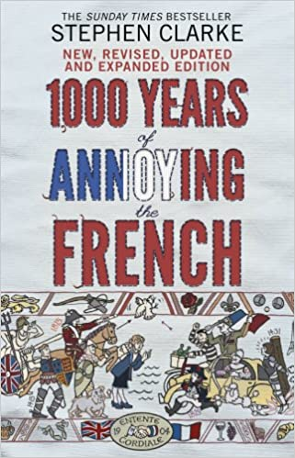
Unico’s 2’nd Choice
Ten centuries' worth of French historical 'facts' bite the dust as Stephen Clarke looks at what has really been going on since 1066 .
Featuring new annoyances – both historical and recent – inflicted on the French, including Napoleon's "banned" chamber pot, Louis XIV's painful operation, Anglo-French jibes during the 2012 London Olympics, French niggles about William and Kate's royal wedding, and much more ...
https://www.amazon.co.uk/Years-Annoying-French-Stephen-Clarke/dp/0552779938

Slide 8
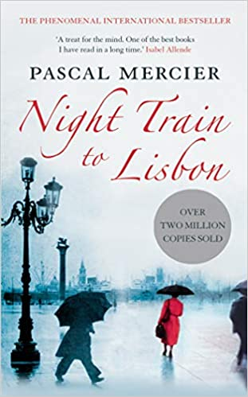
Unico’s 3’Rd Choice
It tells about a middle-aged divorced professor of ancient languages who suddenly abandomns his city, his students and his life and goes to Lisbon, searching for Amadeu De Prado, the author of a book who is haunting him because he feels a strong connections with the writer.
The journey is a self-discovery and talking with the people who knew De Prado when he was alive, the professor Gregorius find out a lot about humanity and Portugal history (a Nation of wich he did not care a lot before). Of course he meet difficulties, above all with Language, that he must learn, and then with people, who Always are rather hazy and who often stop in the middle of their speeches (and I did not like this aspect: people do not act like this in the real world).
https://www.amazon.fr/Night-Train-Lisbon-Pascal-Mercier/dp/1782390901

